Slide 1
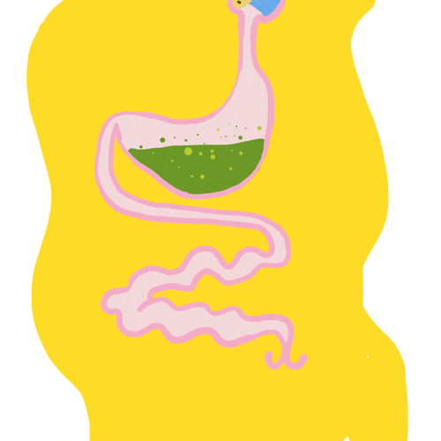
Chemical digestion
AEHBY ATAR Human Biology

Slide 2
Review
Reorder these processes of digestion:
chemical digestion
ingestion
elimination
absorption
mechanical digestion

Slide 3
Review
2. Identify the monomer of each type of macromolecule:
a) protein
b) carbohydrate
c) lipid
d) nucleic acid

Slide 4
Review
Sketch a diagram of enzyme function and pH. Explain why it is this shape.

Slide 5
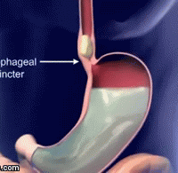
Learning Intentions
Digestion involves the breakdown of large molecules to smaller ones by chemical digestion (by enzymes with distinctive operating conditions and functions that are located in different sections of the digestive system)

Slide 6
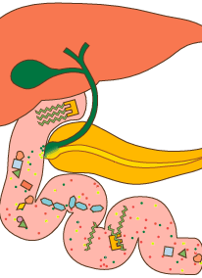
Success Criteria
Define chemical digestion.
Compare the substrate/product, source/location of function, optimal pH and cofactors for different digestive enzymes

Slide 7
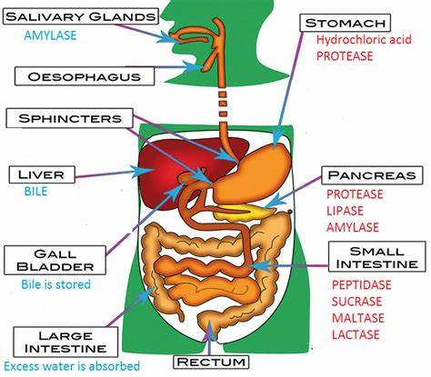
Chemical digestion
Different enzymes are produced by different glands and active in different locations withing the digestive system.

Slide 8
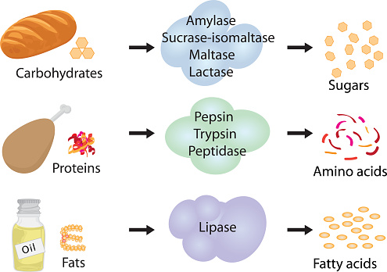
Enzymes are specific to different substrates

Slide 9
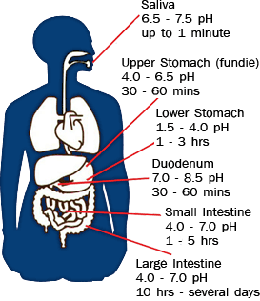
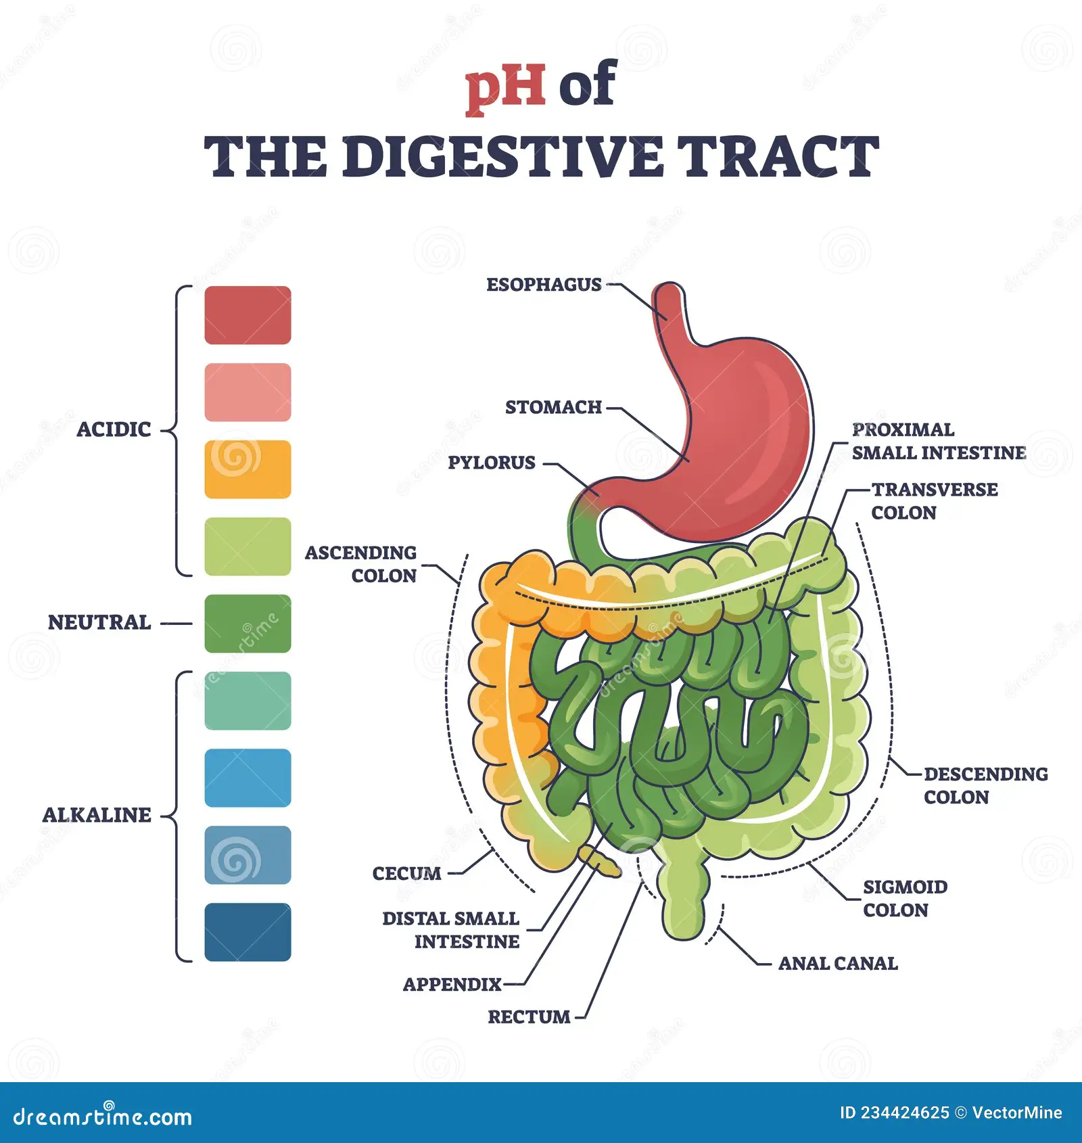

Slide 10
Questions
What type of molecules are found in the lining of the digestive system (aka alimentary canal/ gastrointestinal tract)?
What stops the digestive enzymes from digesting the digestive system?
What is pepsinogen and how is it activated?
Why are there different enzymes for different substrates and why do they work in different locations?

Slide 11
Success Criteria
Define chemical digestion.
Compare the substrate/product, source/location of function, optimal pH and cofactors for different digestive enzymes

